Slide 1

Topic: Random Variables Subject: Calculus and Statistics
Bansilal Ramnath Agarwal Charitable Trust’s
VISHWAKARMA INSTITUTE OF TECHNOLOGY, PUNE – 37
(An Autonomous Institute Affiliated to University of Pune)

Slide 2
Why random variables?
To model uncertainties in engineering systems
To simulate unpredictable phenomenon such as weather conditions and radio noise
To optimize systems for performance and reliability by increasing robustness
To enhance security and privacy of data and communication though encryption and authentication
Applications:
Designing and maintenance of engineering applications
Queueing theory
Reliability Analysis
Noise modelling in signal processing

Slide 3
Random Experiment:
A random experiment is an experiment where the outcome can not be predicted with certainty and it lacks a definite pattern.
Hence in a random experiment the outcome depends on chance. However it has a definite probability of occurrence.
Example:
Tossing of a coin
Drawing a card from a peck of 52 cards
Measuring the amount of rainfall on a random day
Checking the price of stock at a random time
Measuring the height of a randomly selected person

Slide 4
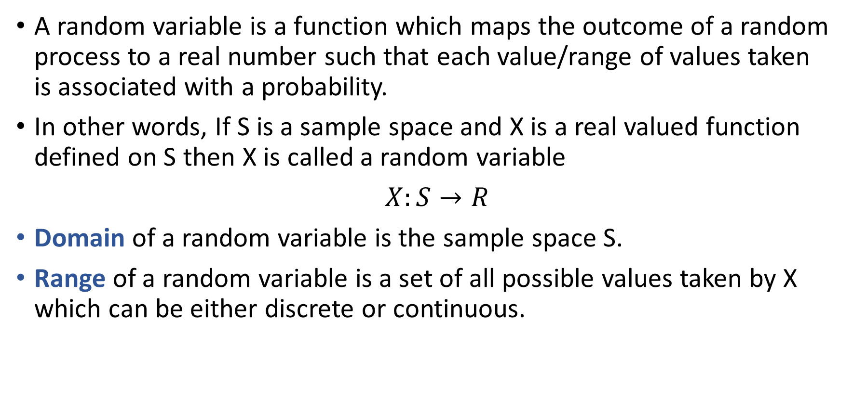
A random variable is a function which maps the outcome of a random process to a real number such that each value/range of values taken is associated with a probability.
In other words, If S is a sample space and X is a real valued function defined on S then X is called a random variable
$X:S→R$
Domain of a random variable is the sample space S.
Range of a random variable is a set of all possible values taken by X which can be either discrete or continuous.

Slide 5


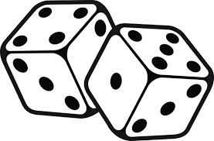
Types of random variables:
Discrete random variable: It is a random variable which takes countable number of possible values.
Example: count of customers,
number of items sold,
total of roll of two dice.

Slide 6
Example:
A balanced coin is tossed four times. List the elements of the sample space that are presumed to be equally likely and the corresponding values x of the random variable X which denotes the total number of heads.
Ans:
Here X=no. of heads in four tosses of a coin
Sample Space={HHHH,HHHT,HHTH,HHTT,HTHH,HTHT,HTTH,HTTT,
THHH,THHT, THTH, THTT, TTHH, TTHT, TTTH, TTTT}
Values of random variable X associated with each outcome are

Slide 7
X(HHHH)=4, X(HHHT)=3, X(HHTH)=3, X(HHTT)=2, X(HTHH)=3, X(HTHT)=2, X(HTTH)=2, X(HTTT)=1, X(THHH)=3, X(THHT)=2, X(THTH)=2, X(THTT)=1 ,
X(TTHH)=2, X(TTHT)=1, X(TTTH)=1, X(TTTT)=0

Slide 8




Continuous random variable: It is a random variable which takes uncountable number of possible values.
Example: Temperature on a given day, percentage obtained in a particular examination, price of stock

Slide 9
Example:
Consider the face of a clock, and suppose that we randomly spin the secondhand around the clock face. Define X as the position where the second hand stops spinning. Discuss the sample space and the range of X in this example
Ans:
Here the sample space can be represented by S = {x | x is a point on a
circle}
The random variable X, defined as the position where the second
hand stops spinning is a continuous random variable with a range
[0,12]

Slide 10
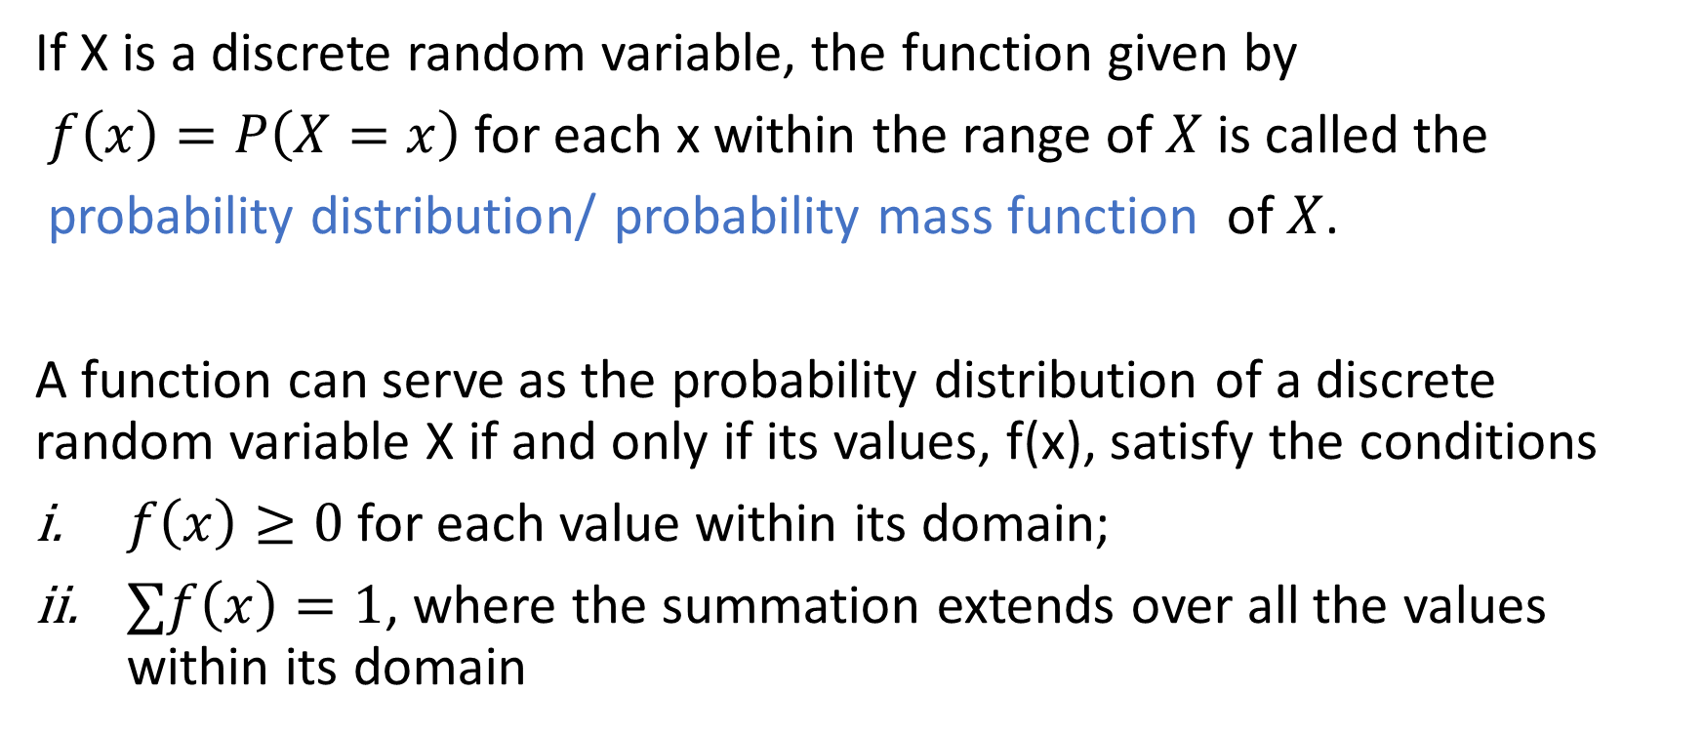
Probability Distribution of a discrete random variable:
If X is a discrete random variable, the function given by
$f\left(x\right)=P\left(X=x\right)$ for each x within the range of $X$ is called the
probability distribution/ probability mass function of $X$.
A function can serve as the probability distribution of a discrete random variable X if and only if its values, f(x), satisfy the conditions
$f\left(x\right)≥0$ for each value within its domain;
$∑f\left(x\right)=1$, where the summation extends over all the values within its domain

Slide 11
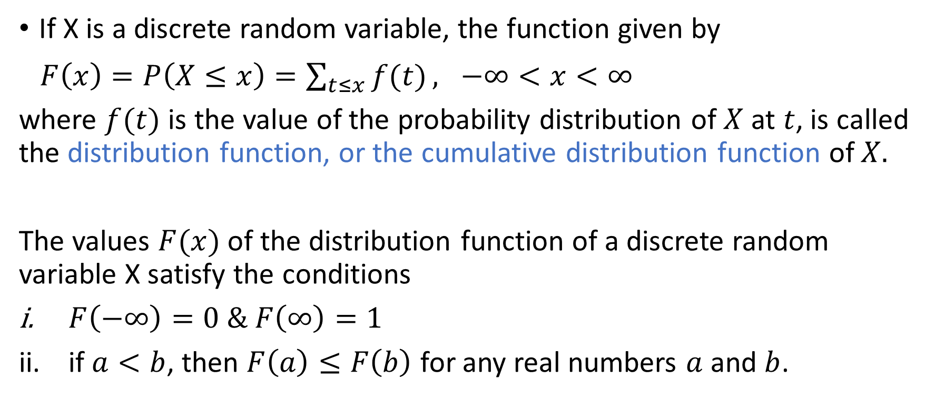
Cumulative Distribution function:
If X is a discrete random variable, the function given by
$F\left(x\right)=P\left(X≤x\right)=\sum_{t≤x}{f(t)}, −∞<x<∞$
where $f(t)$ is the value of the probability distribution of $X$ at $t$, is called the distribution function, or the cumulative distribution function of $X.$
The values $F(x)$ of the distribution function of a discrete random variable X satisfy the conditions
$F\left(−∞\right)=0 \& F\left(∞\right)=1$
if $a<b$, then $F\left(a\right)≤F\left(b\right)$ for any real numbers $a$ and $b$.

Slide 12
Example:
Find the probability distribution of total number of heads obtained in four tosses of a balanced coin. Also find the cumulative distribution function .
Ans:
As seen earlier the values taken by X are 0,1,2,3,4
P(X=0)=P(zero heads)=P({TTTT})=1/16
P(X=1)=P(one head)=P({HTTT, THTT, TTHT, TTTH})=4/16
Similarly P(X=2)=6/16 , P(X=3)=4/16 , P(X=4)=1/16

Slide 13
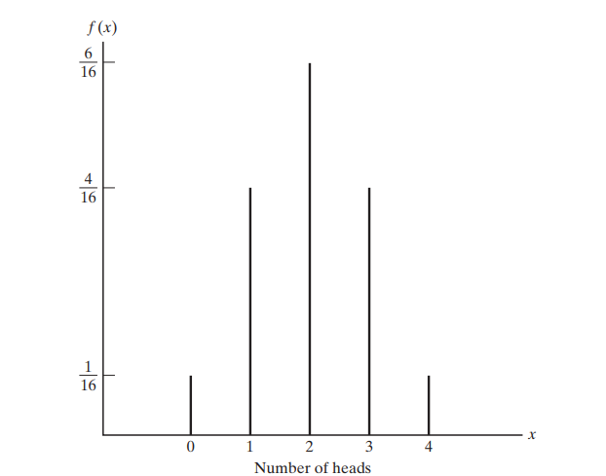
X | 0 | 1 | 2 | 3 | 4
P(X) | 1/16 | 4/16 | 6/16 | 4/16 | 1/16

Slide 14

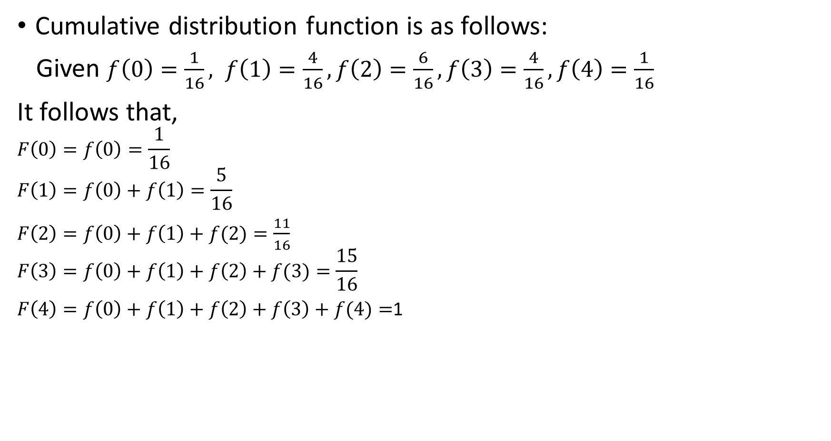
Cumulative distribution function is as follows:
Given $f\left(0\right)=\frac{1}{16}, f\left(1\right)=\frac{4}{16},f\left(2\right)=\frac{6}{16},f\left(3\right)=\frac{4}{16}, f\left(4\right)=\frac{1}{16}$
It follows that,
$$F\left(0\right)=f\left(0\right)=\frac{1}{16}$$
$$F\left(1\right)=f\left(0\right)+f\left(1\right)=\frac{5}{16}$$
$F\left(2\right)=f\left(0\right)+f\left(1\right)+f(2)=\frac{11}{16}$
$$F\left(3\right)=f\left(0\right)+f\left(1\right)+f\left(2\right)+f(3)=\frac{15}{16}$$
$F\left(4\right)=f\left(0\right)+f\left(1\right)+f\left(2\right)+f\left(3\right)+f(4)=$1
$$F\left(x\right)=\left\{\begin{matrix}0 for x<0 \\ \frac{1}{16} for 0≤x<1 \\ \begin{matrix}\frac{5}{16} for 1≤x<2 \\ \begin{matrix}\frac{11}{16} for 2≤x<3 \\ \begin{matrix}\frac{15}{16} for 3≤x<4 \\ 1 for x≥4 \end{matrix}\end{matrix}\end{matrix}\end{matrix}\right.$$

Slide 15
Graph of CDF:
1
15/16
11/16
5/16
1/16
0
1
3
4
2

Slide 16

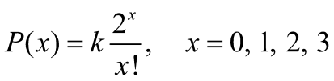
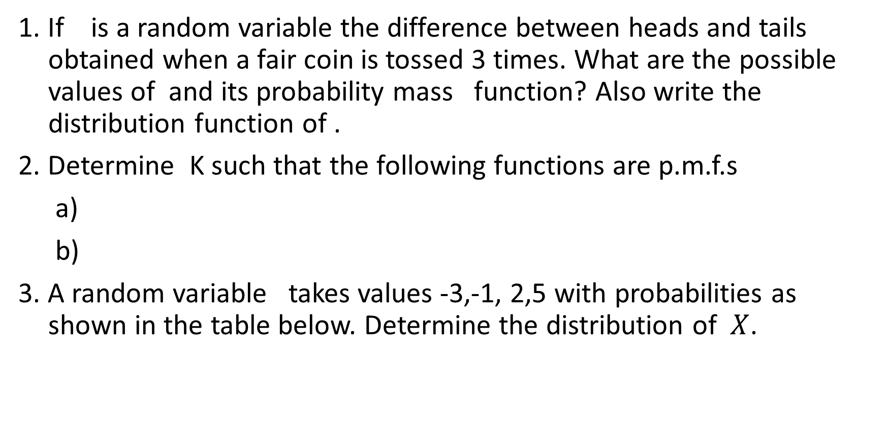
Practice Problems
1. If is a random variable the difference between heads and tails obtained when a fair coin is tossed 3 times. What are the possible values of and its probability mass function? Also write the distribution function of .
2. Determine K such that the following functions are p.m.f.s
a)
b)
3. A random variable takes values -3,-1, 2,5 with probabilities as shown in the table below. Determine the distribution of $X$.

Slide 17
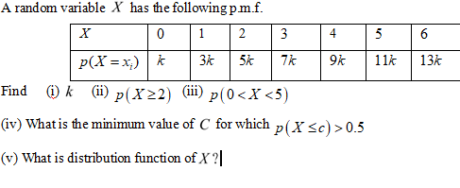

Slide 18
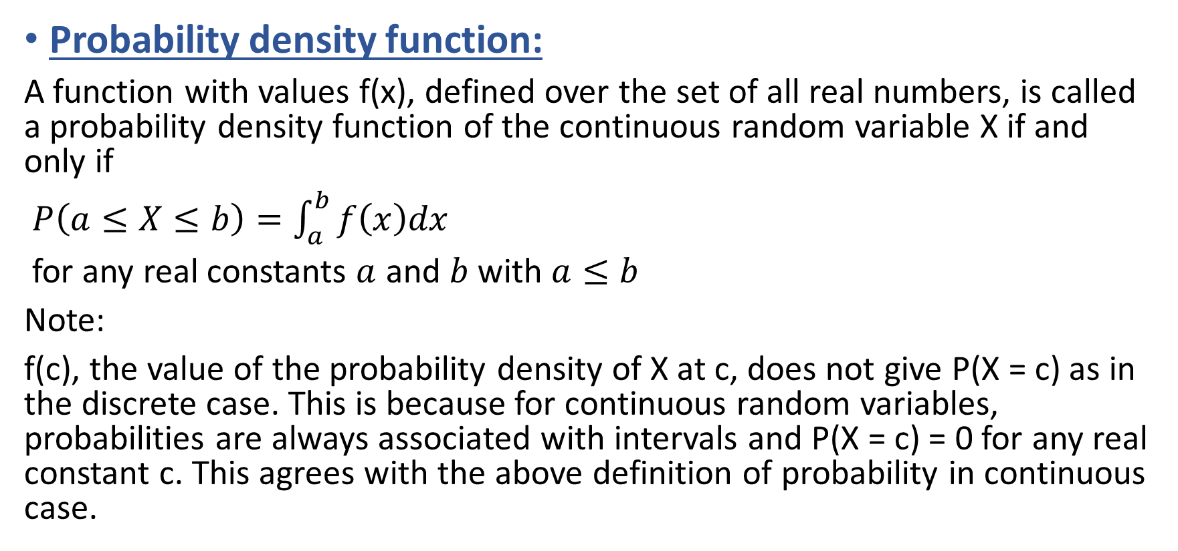
Probability distribution of a continuous random variable:
Probability density function:
A function with values f(x), defined over the set of all real numbers, is called a probability density function of the continuous random variable X if and only if
$P\left(a≤X≤b\right)=\int_{a}^{b}{f\left(x\right)dx}$
for any real constants $a$ and $b$ with $a≤b$
Note:
f(c), the value of the probability density of X at c, does not give P(X = c) as in the discrete case. This is because for continuous random variables, probabilities are always associated with intervals and P(X = c) = 0 for any real constant c. This agrees with the above definition of probability in continuous case.

Slide 19
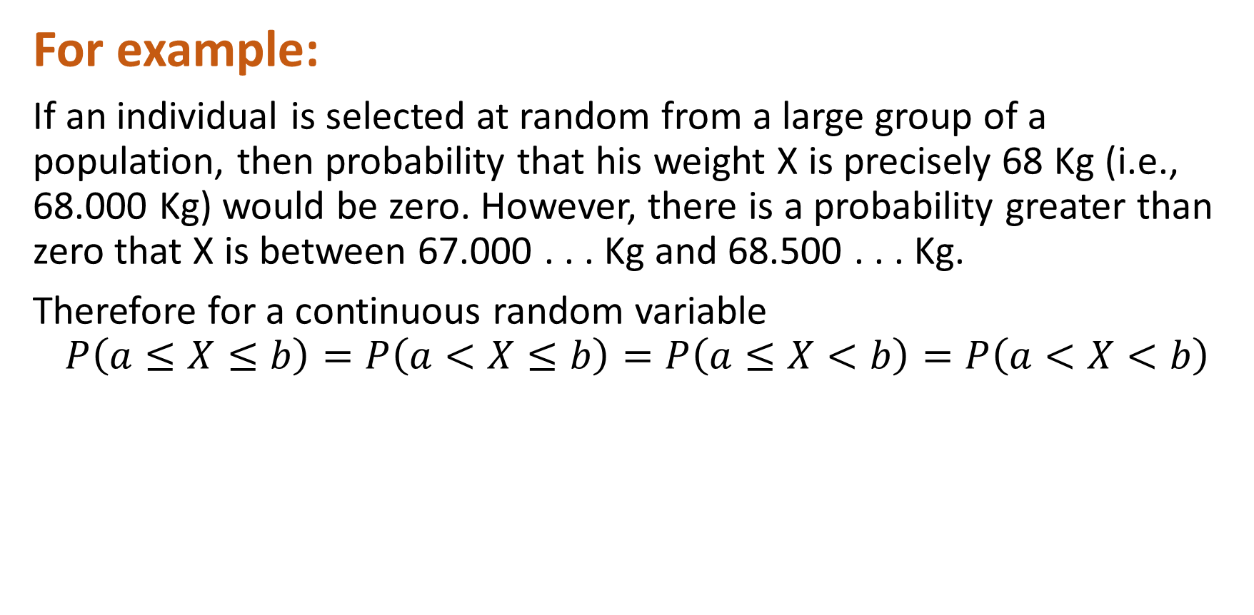
For example:
If an individual is selected at random from a large group of a population, then probability that his weight X is precisely 68 Kg (i.e., 68.000 Kg) would be zero. However, there is a probability greater than zero that X is between 67.000 . . . Kg and 68.500 . . . Kg.
Therefore for a continuous random variable
$$P\left(a≤X≤b\right)=P\left(a<X≤b\right)=P\left(a≤X<b\right)=P\left(a<X<b\right)$$

Slide 20
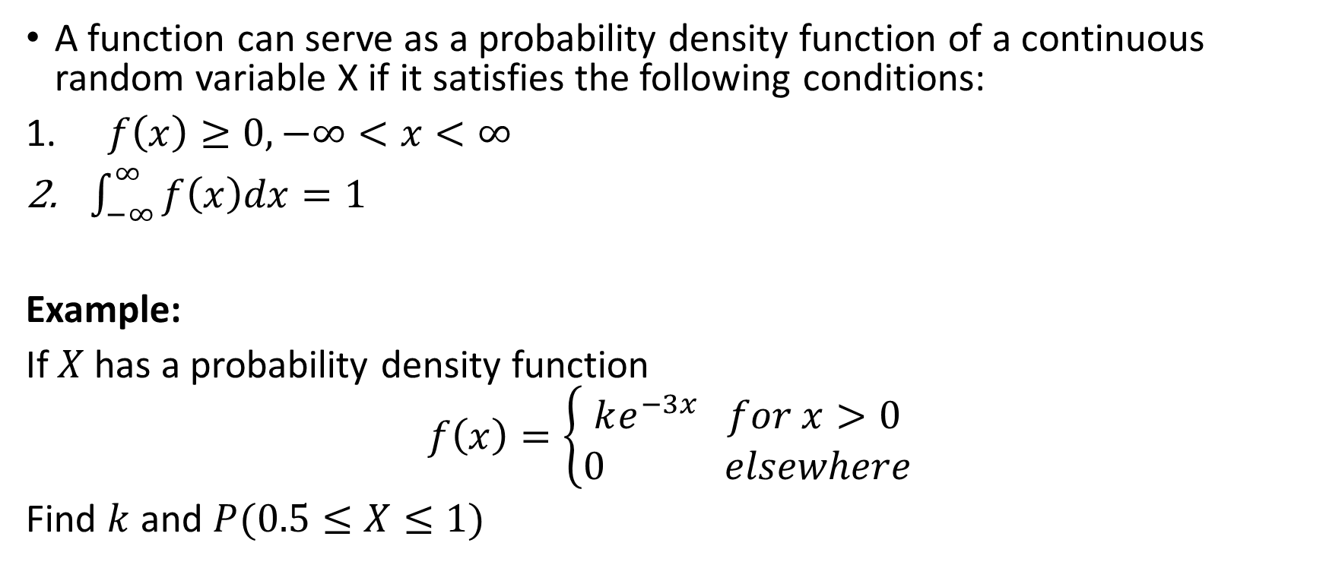
Properties of probability density function:
A function can serve as a probability density function of a continuous random variable X if it satisfies the following conditions:
$f\left(x\right)≥0, −∞<x<∞$
$\int_{−∞}^{∞}{f\left(x\right)dx=1}$
Example:
If $X$ has a probability density function
$$f\left(x\right)=\left\{\begin{matrix}ke^{−3x} for x>0 \\ 0 elsewhere\end{matrix}\right.$$
Find $k$ and $P(0.5≤X≤1)$

Slide 21
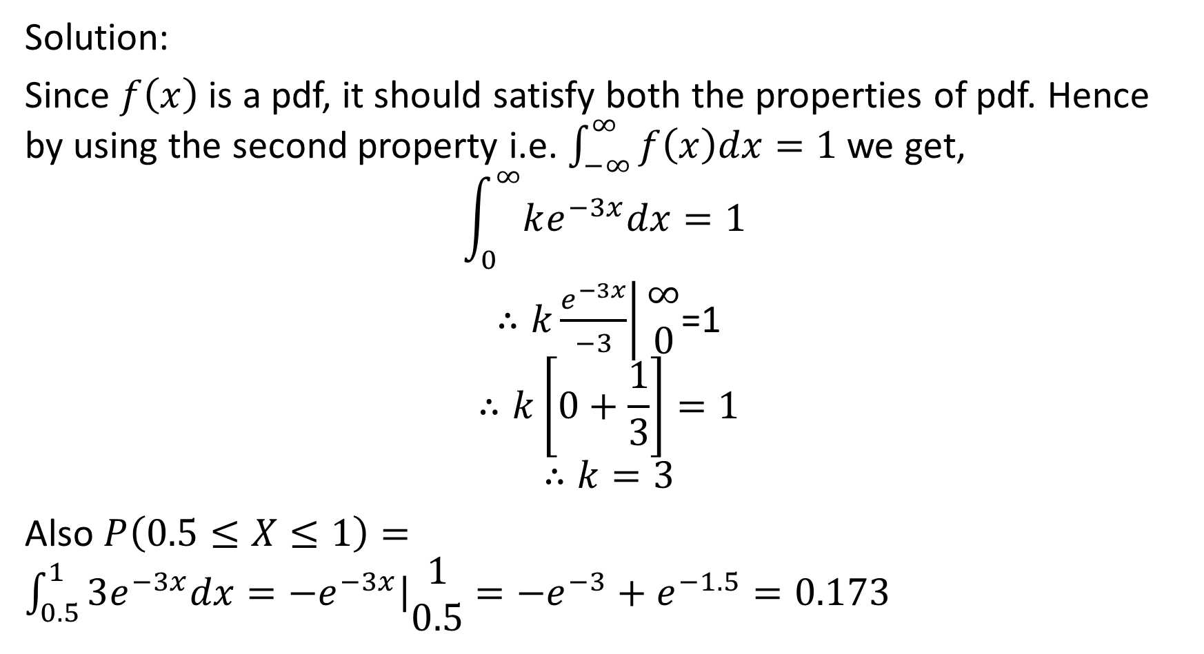
Solution:
Since $f\left(x\right)$ is a pdf, it should satisfy both the properties of pdf. Hence by using the second property i.e. $\int_{−∞}^{∞}{f\left(x\right)dx=1 }$we get,
$$\int_{0}^{∞}{ke^{−3x}dx=1 }$$
$∴\left.k\frac{e^{−3x}}{−3}\right|\begin{matrix}∞ \\ 0\end{matrix}$=1
$$∴k\left[0+\frac{1}{3}\right]=1$$
$$∴k=3$$
Also $P\left(0.5≤X≤1\right)=$ $\int_{0.5}^{1}{3e^{−3x}dx=\left.−e^{−3x}\right|\begin{matrix}1 \\ 0.5\end{matrix}=−e^{−3}+e^{−1.5}=0.173}$

Slide 22
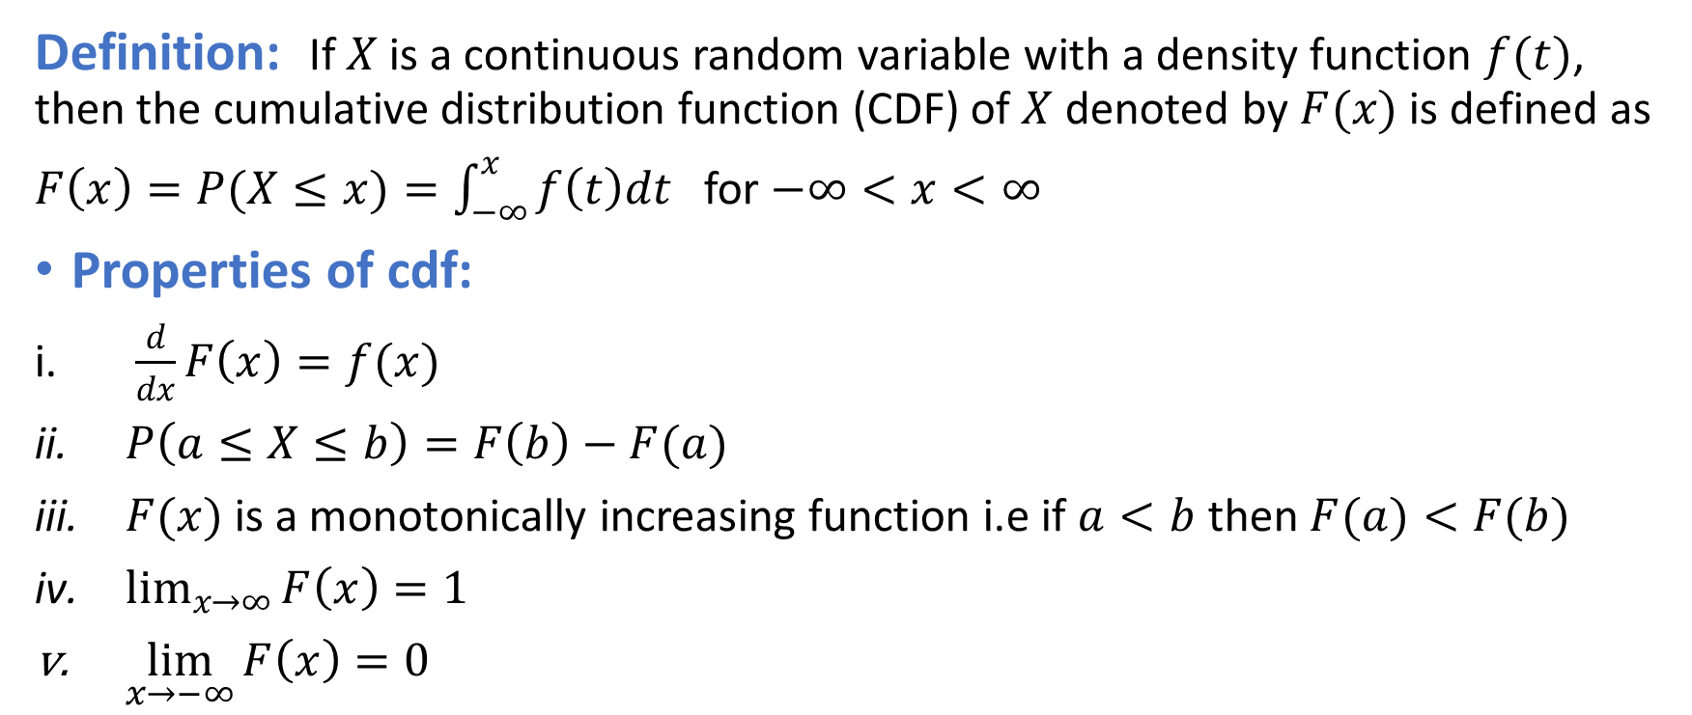
Cumulative distribution function of a continuous random variable:
Definition: If $X$is a continuous random variable with a density function $f(t)$, then the cumulative distribution function (CDF) of $X$ denoted by $F(x)$ is defined as
$F\left(x\right)=P(X≤x)=\int_{−∞}^{x}{f\left(t\right)dt}$ for $−∞<x<∞$
Properties of cdf:
$\frac{d}{dx}F\left(x\right)=f(x)$
$P\left(a≤X≤b\right)=F\left(b\right)−F(a)$
$F(x)$is a monotonically increasing function i.e if $a<b$ then $F(a)<F(b)$
$\lim_{x→∞}{F\left(x\right)=1}$
$\lim_{x→−∞}{F\left(x\right)=0}$

Slide 23
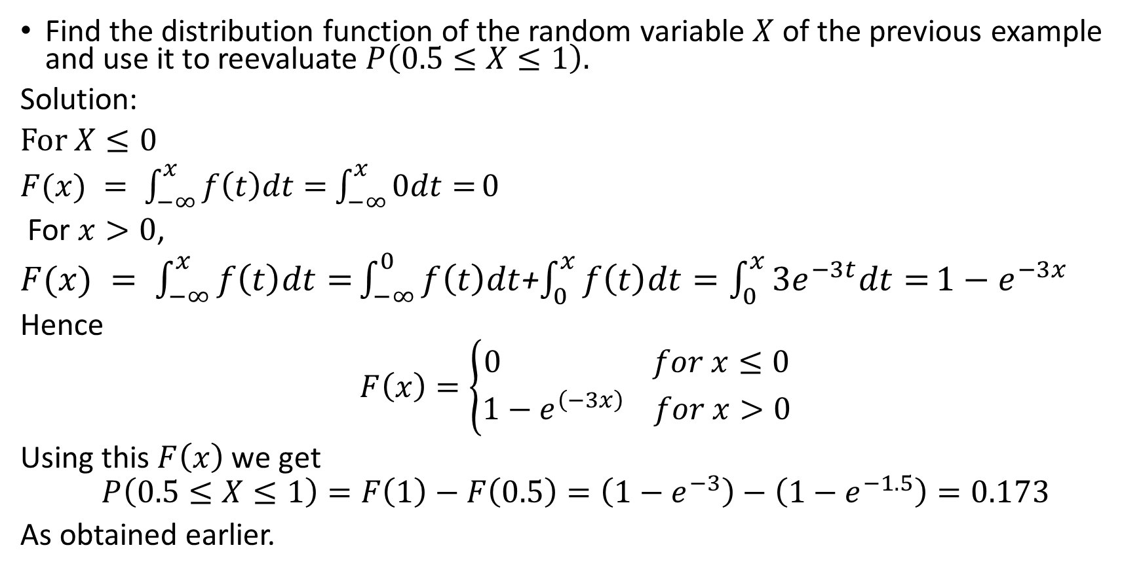
Example:
Find the distribution function of the random variable $X$ of the previous example and use it to reevaluate $P\left(0.5≤X≤1\right).$
Solution:
For $X≤0$
$F(x) = \int_{−∞}^{x}{f\left(t\right)dt=}$ $\int_{−∞}^{x}{0dt=}0$
For $x>0$,
$F(x) = \int_{−∞}^{x}{f\left(t\right)dt=}\int_{−∞}^{0}{f\left(t\right)dt}$+$\int_{0}^{x}{f\left(t\right)dt=\int_{0}^{x}{3e^{−3t}dt=}1−e^{−3x}}$
Hence
$$F\left(x\right)=\left\{\begin{aligned}0 for x≤0 \\ 1−e^{\left(−3x\right)} for x>0\end{aligned}\right.$$
Using this $F\left(x\right)$ we get
$$P\left(0.5≤X≤1\right)=F\left(1\right)−F\left(0.5\right)=\left(1−e^{−3}\right)−\left(1−e^{−1.5}\right)=0.173$$
As obtained earlier.

Slide 24
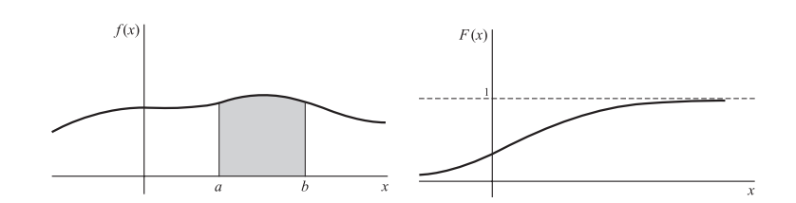

Graphs of pdf and cdf:
If $f(x)$ is the density function for a random variable $X$, then we can represent $y=f(x)$ graphically by a curve as shown in the figure. By properties of pdf, the curve cannot fall below the x axis and the entire area bounded by the curve and the x axis must be. Geometrically the probability that $X$ is between $a and b$, i.e. $P(a≤X≤b)$, is then represented by the shaded region.
The distribution function $F\left(x\right)=P(X≤ x)$is a monotonically increasing function which increases from 0 to 1

Slide 25
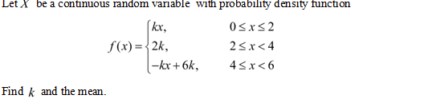
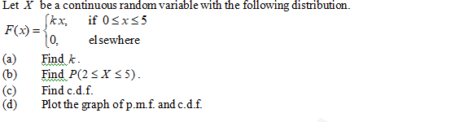
Examples
1.
2

Slide 26
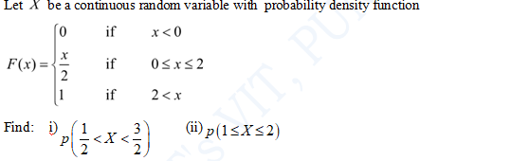
3
4

Slide 27
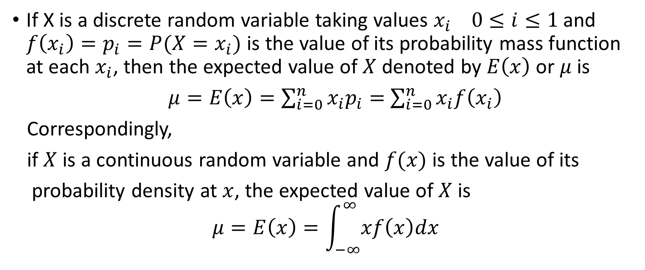
Expectation/mean of a random variable
If X is a discrete random variable taking values $x_{i} 0≤i≤1$and $f\left(x_{i}\right)=p_{i}=P(X=x_{i})$ is the value of its probability mass function at each $x_{i}$, then the expected value of $X$ denoted by $E\left(x\right)$ or $μ$is
$μ=E\left(x\right)=\sum_{i=0}^{n}{x_{i}p_{i}=}$ $\sum_{i=0}^{n}{x_{i}f\left(x_{i}\right)}$
Correspondingly,
if $X$ is a continuous random variable and $f(x)$ is the value of its
probability density at $x$, the expected value of $X$ is
$$μ=E\left(x\right)=\int_{−∞}^{∞}{xf\left(x\right)dx}$$

Slide 28
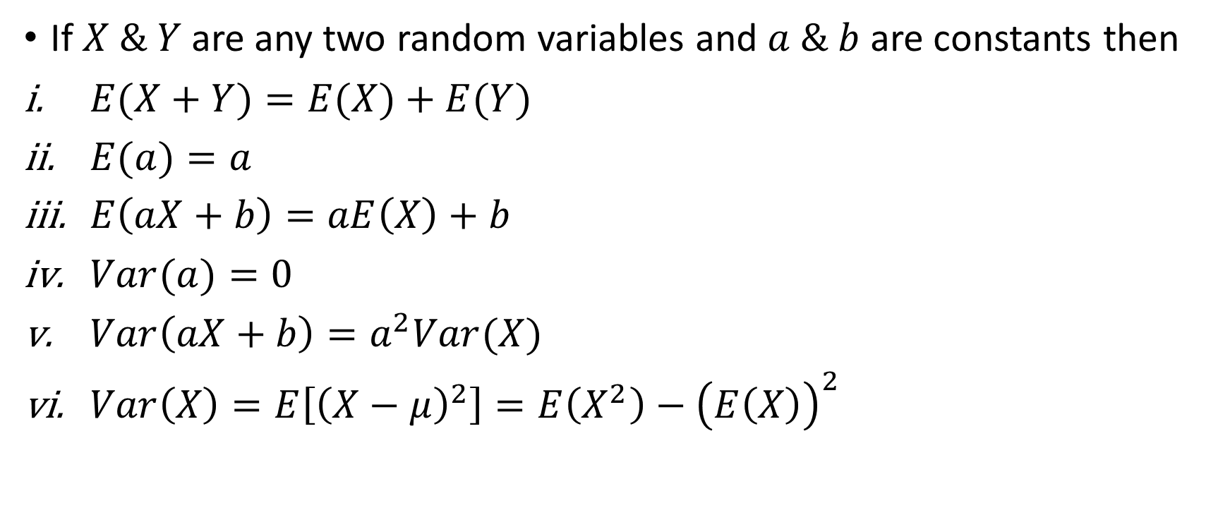
Properties of expectation and variance:
If $X \& Y$are any two random variables and $a \& b$ are constants then
$E(X+Y)=E(X)+E(Y)$
$E(a)=a$
$E\left(aX+b\right)=aE\left(X\right)+b$
$Var(a)=0$
$Var\left(aX+b\right)=a^{2}Var(X)$
$Var\left(X\right)=E\left[{\left(X−μ\right)}^{2}\right]=E\left(X^{2}\right)−{\left(E\left(X\right)\right)}^{2}$

Slide 29
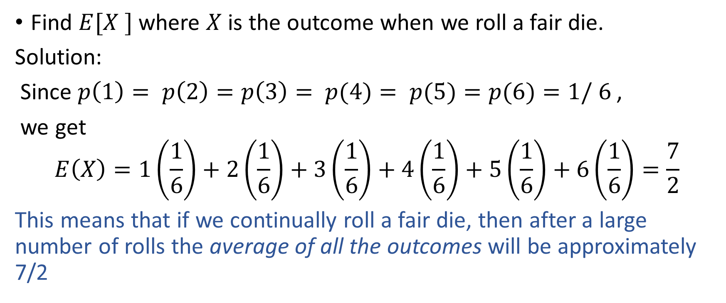
Example 1:
Find $E[X ]$ where $X$ is the outcome when we roll a fair die.
Solution:
Since $p\left(1\right)= p\left(2\right)=p\left(3\right)= p(4)= p(5)=p(6)=1/ 6$,
we get
$$E\left(X\right)=1\left(\frac{1}{6}\right)+2\left(\frac{1}{6}\right)+3\left(\frac{1}{6}\right)+4\left(\frac{1}{6}\right)+5\left(\frac{1}{6}\right)+6\left(\frac{1}{6}\right)=\frac{7}{2}$$
This means that if we continually roll a fair die, then after a large number of rolls the average of all the outcomes will be approximately 7/2

Slide 30
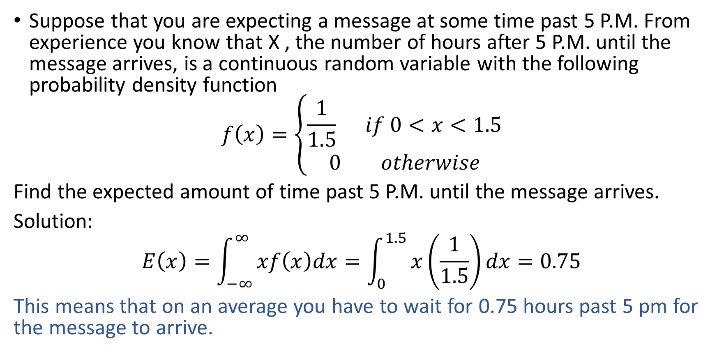
Example 2:
Suppose that you are expecting a message at some time past 5 P.M. From experience you know that X , the number of hours after 5 P.M. until the message arrives, is a continuous random variable with the following probability density function
$$f\left(x\right)=\left\{\begin{aligned}\frac{1}{1.5} if 0<x<1.5 \\ 0 otherwise\end{aligned}\right.$$
Find the expected amount of time past 5 P.M. until the message arrives.
Solution:
$$E\left(x\right)=\int_{−∞}^{∞}{xf\left(x\right)dx=\int_{0}^{1.5}{x\left(\frac{1}{1.5}\right)dx=0.75}}$$
This means that on an average you have to wait for 0.75 hours past 5 pm for the message to arrive.

Slide 31
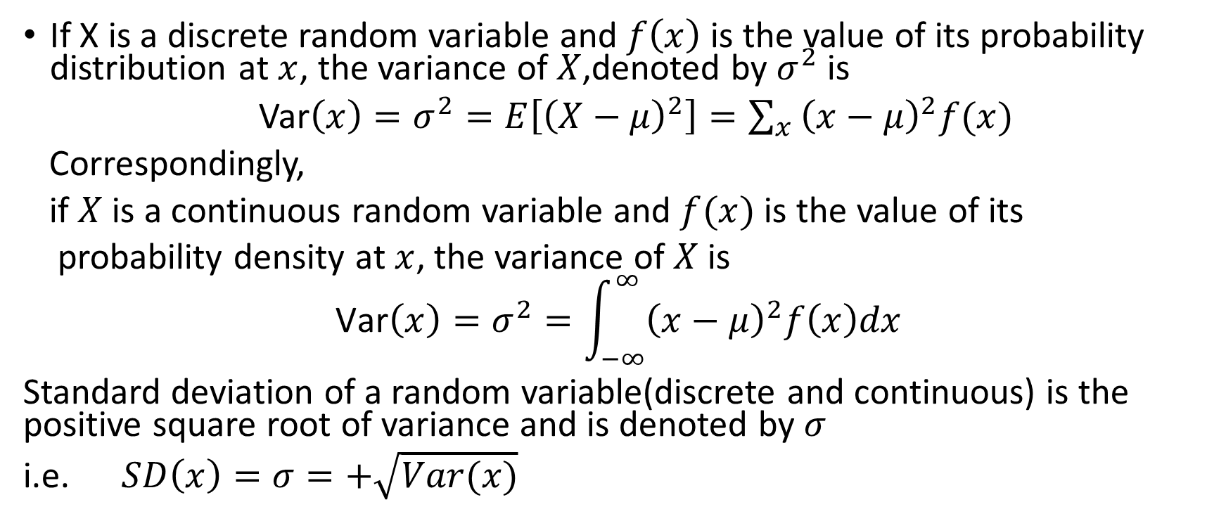
Variance and standard deviation of a random variable
If X is a discrete random variable and $f\left(x\right)$ is the value of its probability distribution at $x$, the variance of $X$,denoted by $σ^{2}$ is
Var$\left(x\right)=σ^{2}=E\left[{\left(X−μ\right)}^{2}\right]=\sum_{x}{{\left(x−μ\right)}^{2}f(x)}$
Correspondingly,
if $X$ is a continuous random variable and $f(x)$ is the value of its
probability density at $x$, the variance of $X$ is
$$\text{Var}\left(x\right)=σ^{2}=\int_{−∞}^{∞}{{\left(x−μ\right)}^{2}f\left(x\right)dx}$$
Standard deviation of a random variable(discrete and continuous) is the positive square root of variance and is denoted by $σ$
i.e. $SD\left(x\right)=σ=+\sqrt{Var(x)}$

Slide 32
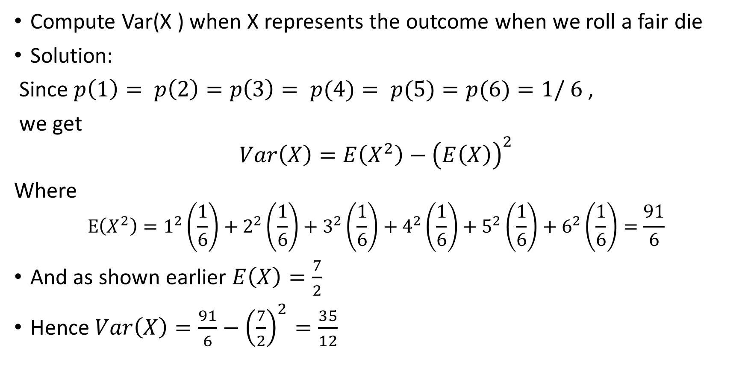
Example 1 :
Compute Var(X ) when X represents the outcome when we roll a fair die
Solution:
Since $p\left(1\right)= p\left(2\right)=p\left(3\right)= p(4)= p(5)=p(6)=1/ 6$,
we get
$$Var\left(X\right)=E\left(X^{2}\right)−{\left(E\left(X\right)\right)}^{2}$$
Where
$$E\left(X^{2}\right)=1^{2}\left(\frac{1}{6}\right)+2^{2}\left(\frac{1}{6}\right)+3^{2}\left(\frac{1}{6}\right)+4^{2}\left(\frac{1}{6}\right)+5^{2}\left(\frac{1}{6}\right)+6^{2}\left(\frac{1}{6}\right)=\frac{91}{6}$$
And as shown earlier $E\left(X\right)=\frac{7}{2}$
Hence $Var\left(X\right)=\frac{91}{6}−{\left(\frac{7}{2}\right)}^{2}=\frac{35}{12}$

Slide 33
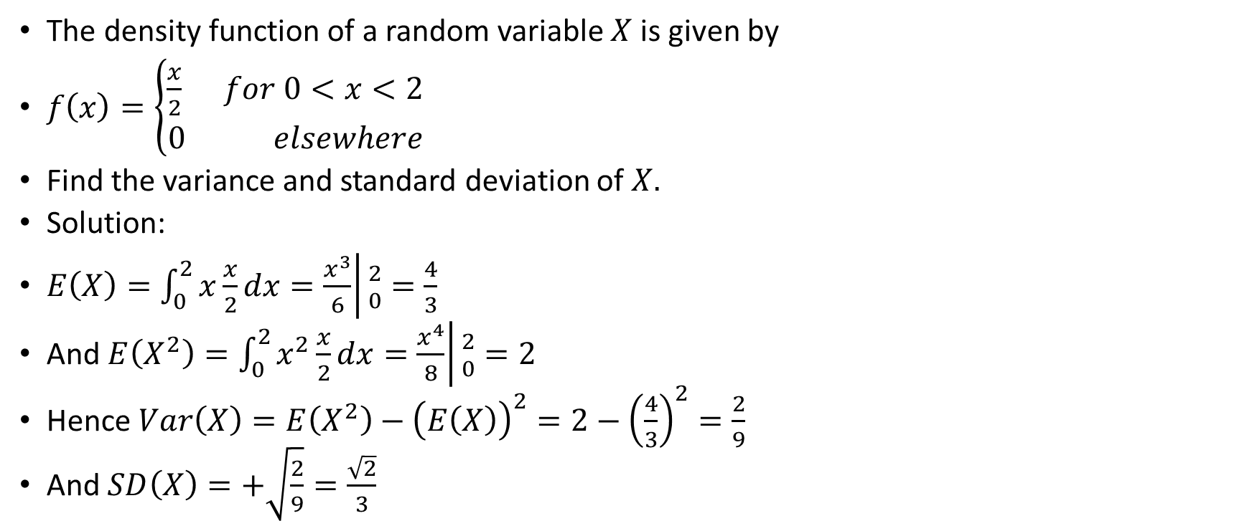
Example 2:
The density function of a random variable $X$ is given by
$f\left(x\right)=\left\{\begin{aligned}\frac{x}{2} for 0<x<2 \\ 0 elsewhere\end{aligned}\right.$
Find the variance and standard deviation of $X.$
Solution:
$E\left(X\right)=\int_{0}^{2}{x\frac{x}{2}dx=\left.\frac{x^{3}}{6}\right|{2 \atop 0}}=\frac{4}{3}$
And $E\left(X^{2}\right)=\int_{0}^{2}{x^{2}\frac{x}{2}dx=\left.\frac{x^{4}}{8}\right|{2 \atop 0}}=2$
Hence $Var\left(X\right)=E\left(X^{2}\right)−{\left(E\left(X\right)\right)}^{2}=2−{\left(\frac{4}{3}\right)}^{2}=\frac{2}{9}$
And $SD\left(X\right)=+\sqrt{\frac{2}{9}}=\frac{\sqrt{2}}{3}$

Slide 34
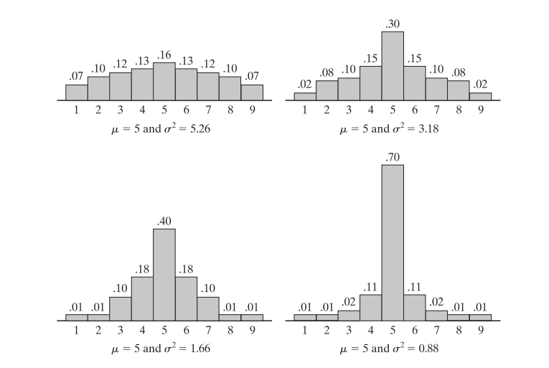
Interpretation of variance: Variance represents the spread or dispersion of the distribution of a random variable

Slide 35
Examples:
A box contains 8 items of which 2 are defective. A person draws 3 items from the box. Determine the expected number of defective items he has drawn.
A player tosses two fair coins. The player wins $2 if two heads occur, and $1 if one head occur. On the other hand, the player losses $3 if no heads occur. Find the expected gain of the player. Is the game fair?
Two cards are drawn one by one with replacement from ten cards numbered 1 to 10. Find expectation of the product of the numbers on the drawn cards.
If it rains, a rain coat dealer can earn Rs 500 per day. If it is a dry day, he can lose Rs 100 per day. What is his expectation, if the probability of rain is 0.4?
If it rains, a rain coat dealer can earn Rs 500 per day. If it is a dry day, he can lose Rs 100 per day. What is his expectation, if the probability of rain is 0.4?

Slide 36

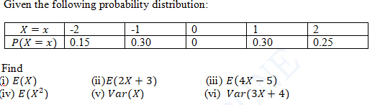
Examples:

Slide 37
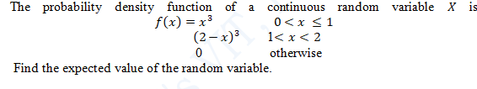

Slide 38
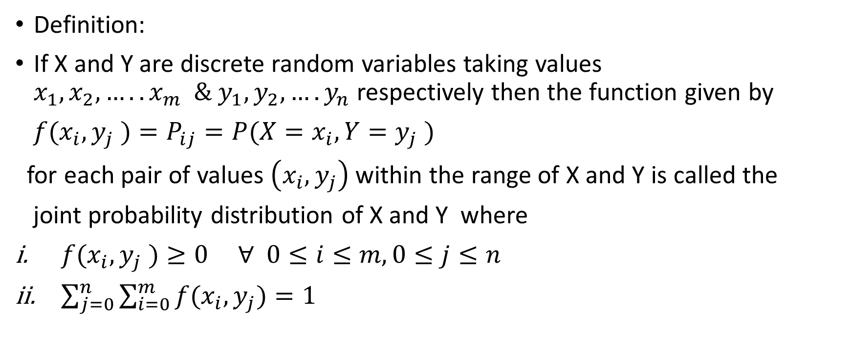
Bivariate/Joint probability distribution:
Definition:
If X and Y are discrete random variables taking values $x_{1},x_{2},…..x_{m} \& y_{1},y_{2},….y_{n}$ respectively then the function given by
$f(x_{i},y_{j} )=P_{ij}=P(X=x_{i},Y=y_{j} )$
for each pair of values $\left(x_{i},y_{j}\right)$within the range of X and Y is called the
joint probability distribution of X and Y where
$f(x_{i},y_{j} )≥0 ∀ 0≤i≤m, 0≤j≤n$
$\sum_{j=0}^{n}{\sum_{i=0}^{m}{f(x_{i},y_{j})}}=1$

Slide 39
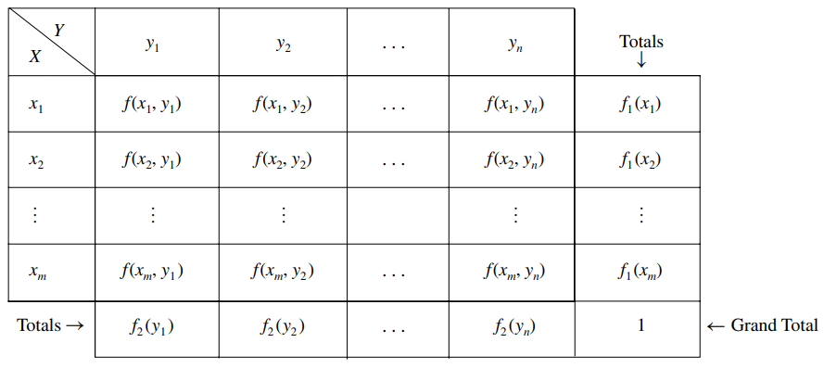
Joint Probability Table

Slide 40
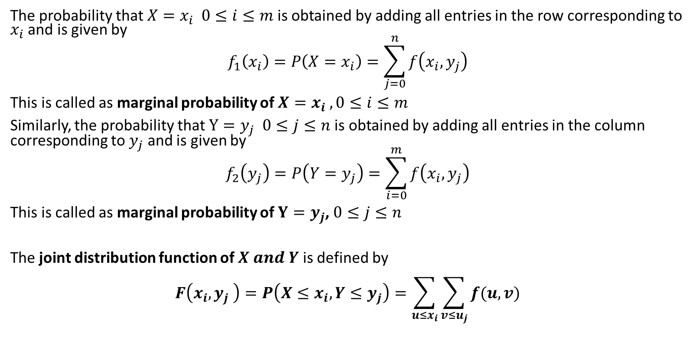
Marginal Probabilities:
The probability that $X=x_{i} 0≤i≤m$is obtained by adding all entries in the row corresponding to $x_{i}$ and is given by
$$f_{1}\left(x_{i}\right)=P\left(X=x_{i}\right)=\sum_{j=0}^{n}{f\left(x_{i},y_{j}\right)}$$
This is called as marginal probability of $X=x_{i}$ $, 0≤i≤m$
Similarly, the probability that $Y=y_{j} 0≤j≤n$is obtained by adding all entries in the column corresponding to $y_{j}$ and is given by
$$f_{2}\left(y_{j}\right)=P\left(Y=y_{j}\right)=\sum_{i=0}^{m}{f\left(x_{i},y_{j}\right)}$$
This is called as marginal probability of $Y=y_{j}$, $0≤j≤n$
The joint distribution function of $X and Y$is defined by
$$F\left(x_{i},y_{j} \right)=P\left(X≤x_{i},Y≤y_{j}\right)=\sum_{u≤x_{i}}{\sum_{v≤u_{j}}{f(u,v)}}$$

Slide 41
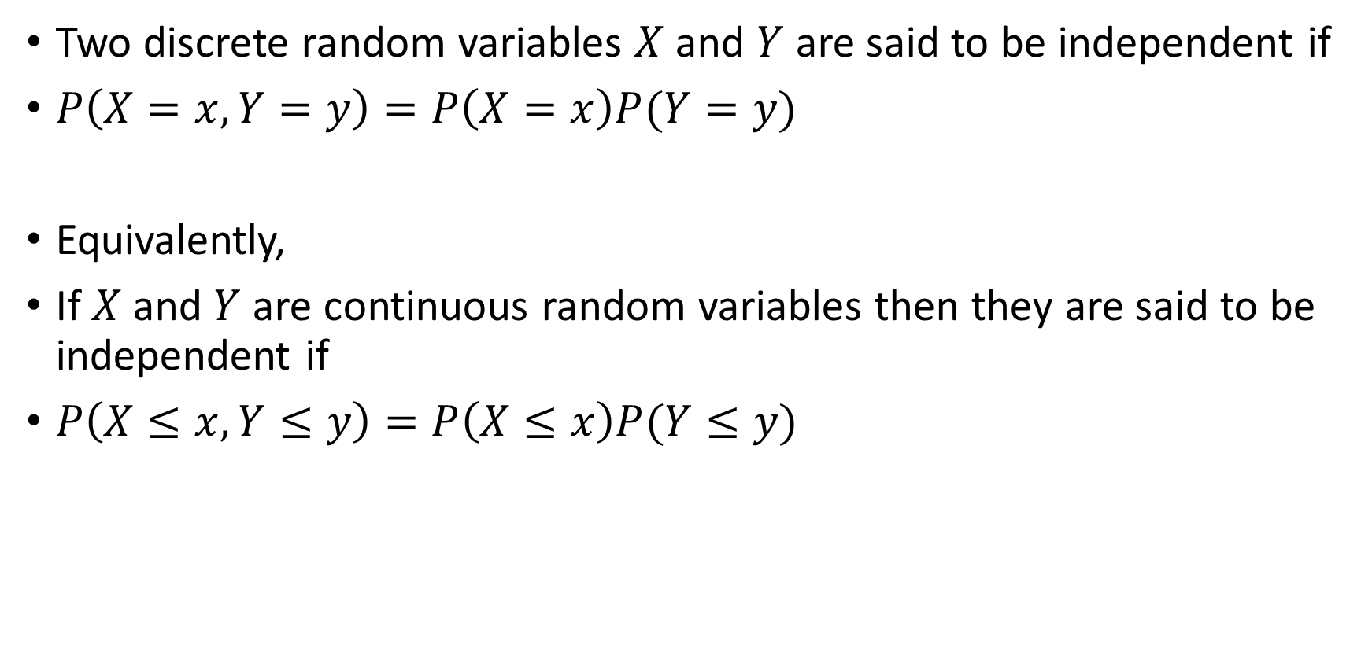
Independent random variables:
Two discrete random variables $X$and $Y$ are said to be independent if
$P\left(X=x, Y=y\right)=P\left(X=x\right)P(Y=y)$
Equivalently,
If $X$and $Y$ are continuous random variables then they are said to be independent if
$P\left(X≤x, Y≤y\right)=P\left(X≤x\right)P(Y≤y)$

Slide 42
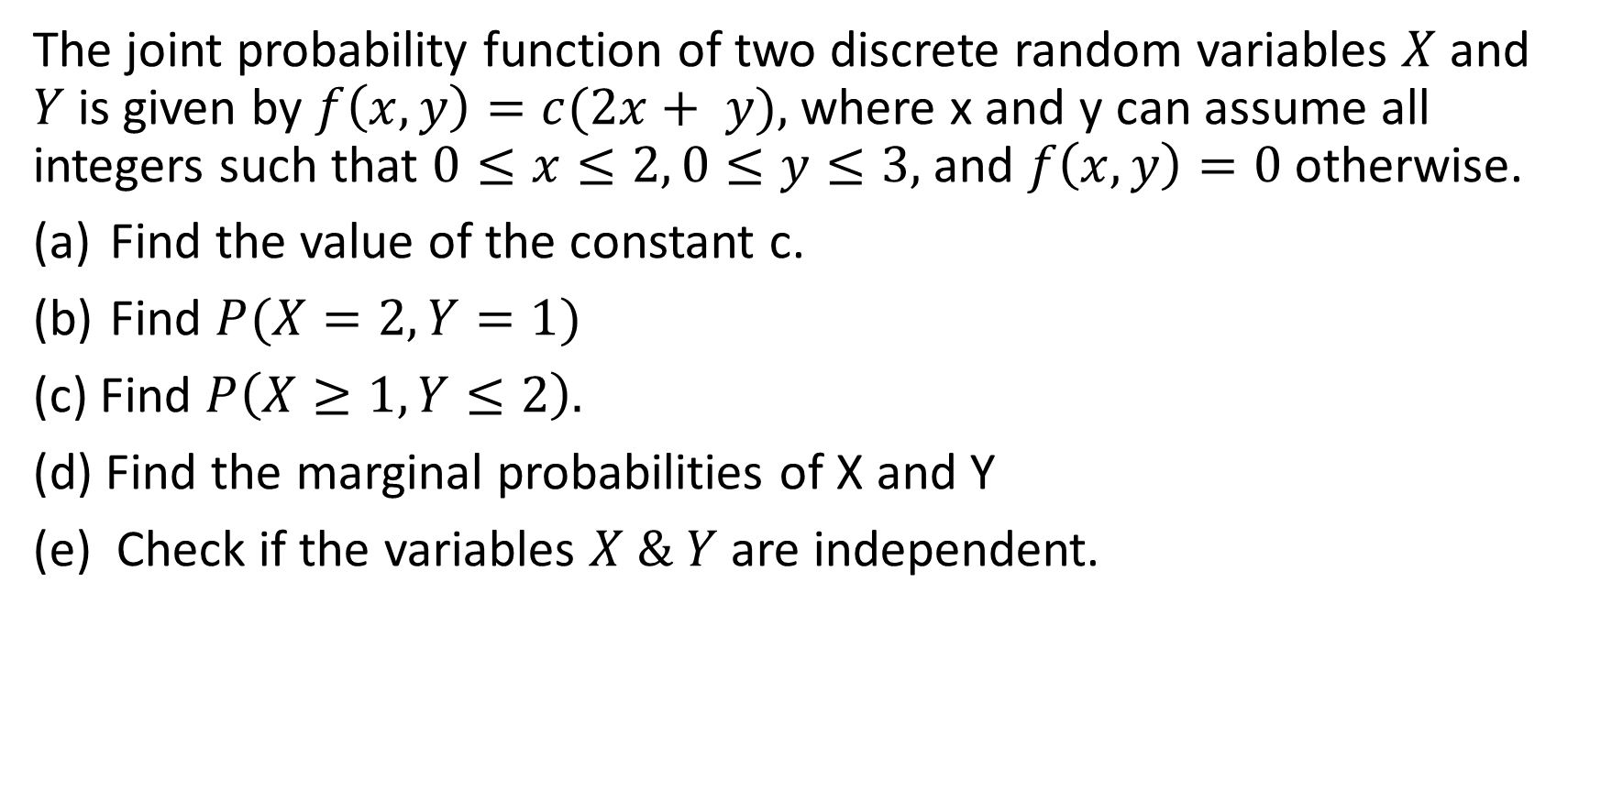
Example:
The joint probability function of two discrete random variables $X$ and $Y$is given by $f\left(x, y\right)=c(2x+ y),$where x and y can assume all integers such that $0≤x≤2, 0≤y≤3,$and $f\left(x, y\right)=0$otherwise.
Find the value of the constant c.
Find $P(X=2, Y=1)$
(c) Find $P\left(X≥1, Y≤2\right).$
(d) Find the marginal probabilities of X and Y
(e) Check if the variables $X \& Y$ are independent.

Slide 43
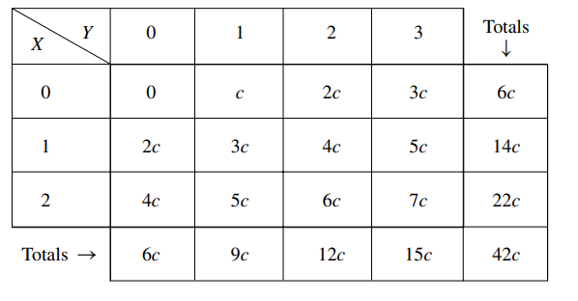
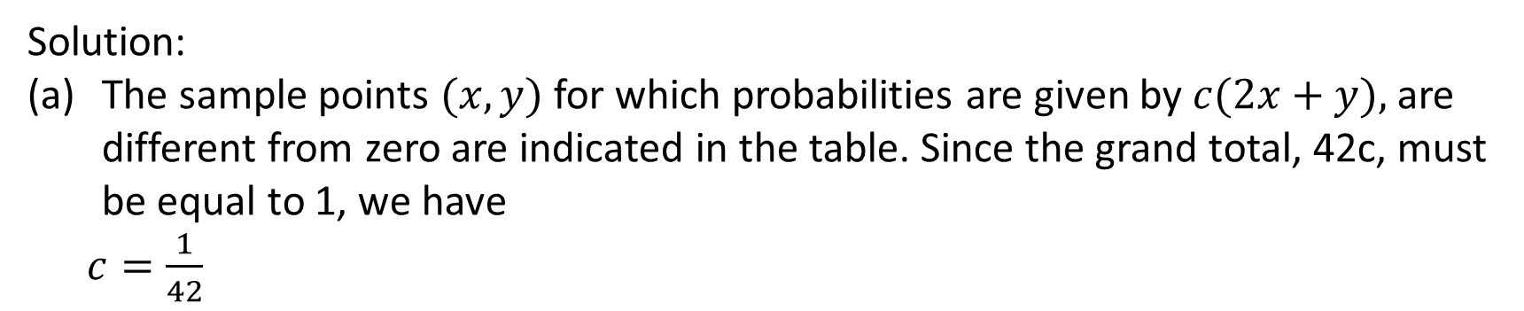
Solution:
The sample points $(x, y)$for which probabilities are given by $c(2x+y),$are different from zero are indicated in the table. Since the grand total, 42c, must be equal to 1, we have
$c=\frac{1}{42}$

Slide 44
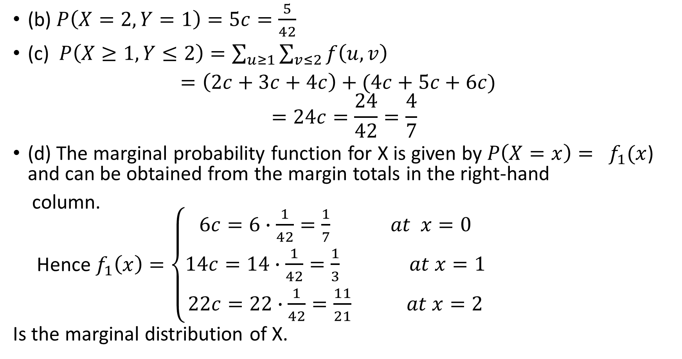
(b) $P\left(X=2,Y=1\right)=5c=\frac{5}{42}$
(c) $P\left(X≥1, Y≤2\right)=\sum_{u≥1}{\sum_{v≤2}{f\left(u,v\right)}}$
$=\left(2c+3c+4c\right)+(4c+5c+6c)$
$$=24c=\frac{24}{42}=\frac{4}{7}$$
(d) The marginal probability function for X is given by $P\left(X=x\right)= f_{1}(x$) and can be obtained from the margin totals in the right-hand
column.
Hence $f_{1}\left(x\right)=\left\{\begin{aligned}6c=6∙\frac{1}{42}=\frac{1}{7} at x=0 \\ 14c=14∙\frac{1}{42}=\frac{1}{3} at x=1 \\ 22c=22∙\frac{1}{42}=\frac{11}{21} at x=2\end{aligned}\right.$
Is the marginal distribution of X.

Slide 45
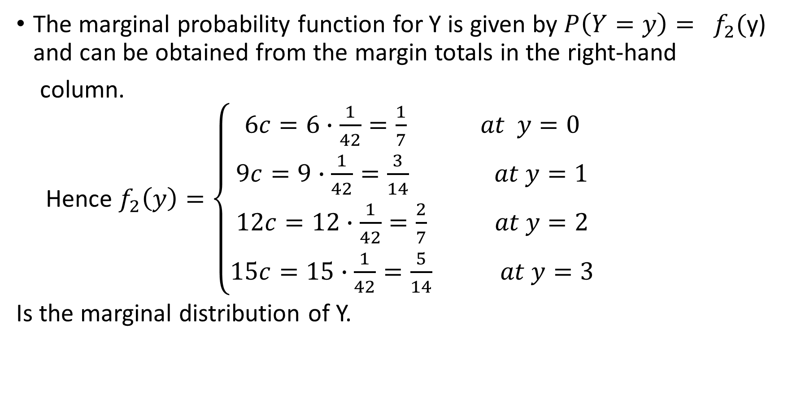
The marginal probability function for Y is given by $P\left(Y=y\right)= f_{2}($y) and can be obtained from the margin totals in the right-hand
column.
Hence $f_{2}\left(y\right)=\left\{\begin{aligned}6c=6∙\frac{1}{42}=\frac{1}{7} at y=0 \\ 9c=9∙\frac{1}{42}=\frac{3}{14} at y=1 \\ 12c=12∙\frac{1}{42}=\frac{2}{7} at y=2 \\ 15c=15∙\frac{1}{42}=\frac{5}{14} at y=3\end{aligned}\right.$
Is the marginal distribution of Y.

Slide 46
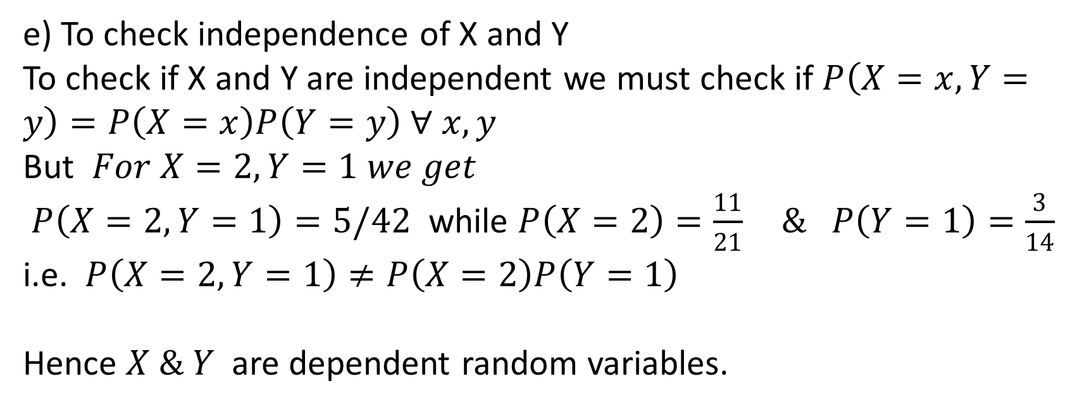
e) To check independence of X and Y
To check if X and Y are independent we must check if $P\left(X=x,Y=y\right)=P\left(X=x\right)P\left(Y=y\right) ∀ x,y$
But $For X=2,Y=1 we get$
$P\left(X=2,Y=1\right)=5/42$ while $P\left(X=2\right)=\frac{11}{21} \& P\left(Y=1\right)=\frac{3}{14}$
i.e. $P\left(X=2,Y=1\right)≠P\left(X=2\right)P\left(Y=1\right)$
Hence $X \& Y$ are dependent random variables.

Slide 47
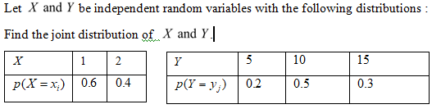
Practice Problems

Slide 48
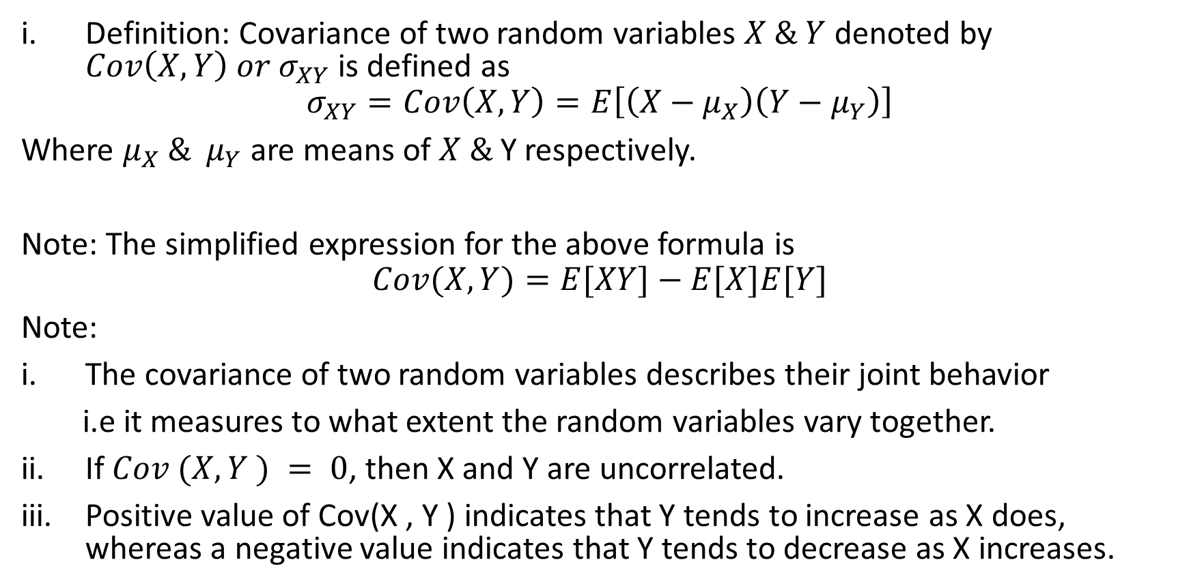
Covariance:
Definition: Covariance of two random variables $X \& Y$ denoted by $Cov\left(X,Y\right) or σ_{XY}$is defined as
$$σ_{XY}=Cov\left(X,Y\right)=E\left[\left(X−μ_{X}\right)\left(Y−μ_{Y}\right)\right]$$
Where $μ_{X} \& μ_{Y}$ are means of $X \&$Y respectively.
Note: The simplified expression for the above formula is
$$Cov(X,Y)=E[XY]−E[X]E[Y]$$
Note:
The covariance of two random variables describes their joint behavior
i.e it measures to what extent the random variables vary together.
If $Cov (X, Y ) = 0$, then X and Y are uncorrelated.
Positive value of Cov(X , Y ) indicates that Y tends to increase as X does, whereas a negative value indicates that Y tends to decrease as X increases.

Slide 49
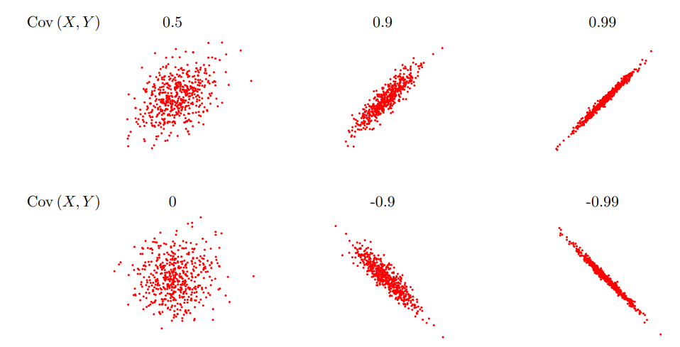
Graphical view of various covariance values

Slide 50

Properties of covariance:
$Cov\left(X,Y\right)=Cov\left(Y,X\right)$
$Cov\left(X,X\right)=Var\left(X\right)$
$Cov\left(aX,Y\right)=a Cov(X,Y)$
$Cov\left(X+Z,Y\right)=Cov\left(X,Y\right)+Cov(Z,Y)$

Slide 51
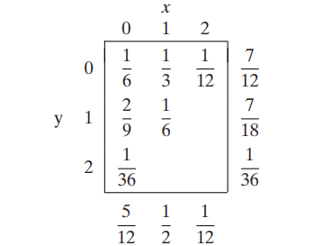
Example:
The joint and marginal probabilities of X and Y, the numbers of aspirin and sedative caplets among two caplets drawn at random from a bottle containing three aspirin, two sedative, and four laxative caplets, are recorded as follows:
Find the covariance of X and Y

Slide 52
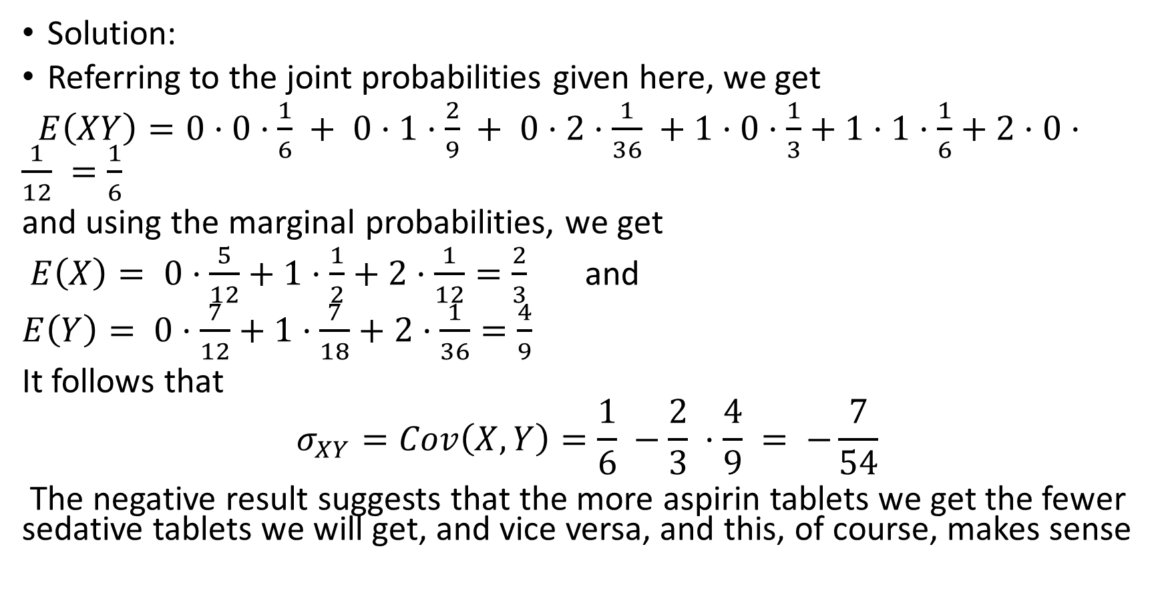
Solution:
Referring to the joint probabilities given here, we get
$E\left(XY\right)=0·0·\frac{1}{6} + 0·1·\frac{2}{9} + 0·2·\frac{1}{36} +1·0·\frac{1}{3}+1·1·\frac{1}{6}+2·0·\frac{1}{12} =\frac{1}{6}$
and using the marginal probabilities, we get
$E\left(X\right)= 0·\frac{5}{12}+1·\frac{1}{2}+2·\frac{1}{12}=\frac{2}{3}$ and
$E\left(Y\right)= 0·\frac{7}{12}+1·\frac{7}{18}+2·\frac{1}{36}=\frac{4}{9}$
It follows that
$$σ_{XY}=Cov\left(X,Y\right)=\frac{1}{6} −\frac{2}{3} ·\frac{4}{9} = −\frac{7}{54}$$
The negative result suggests that the more aspirin tablets we get the fewer sedative tablets we will get, and vice versa, and this, of course, makes sense

Slide 53
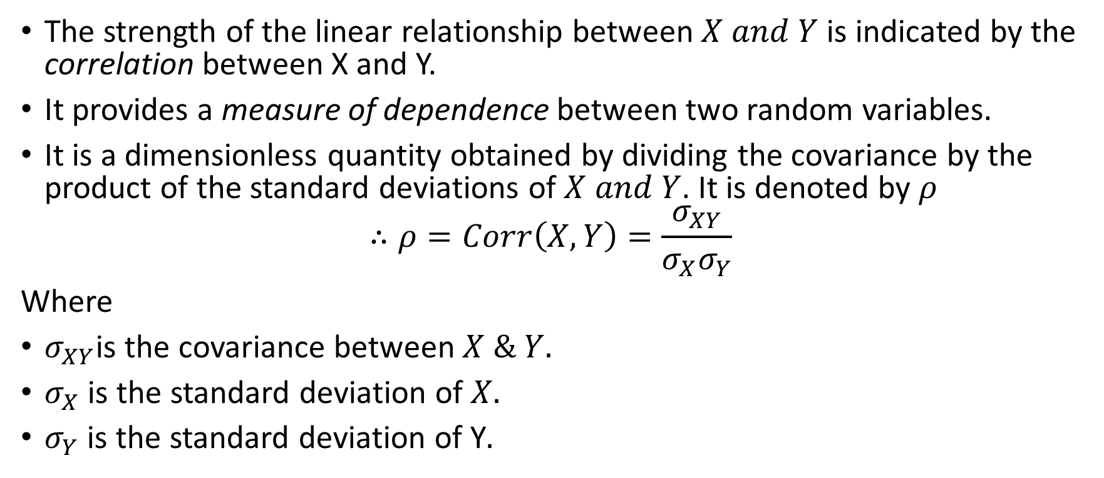
Correlation coefficient:
The strength of the linear relationship between $X and Y$is indicated by the correlation between X and Y.
It provides a measure of dependence between two random variables.
It is a dimensionless quantity obtained by dividing the covariance by the product of the standard deviations of $X and Y$. It is denoted by $ρ$
$$∴ρ=Corr\left(X,Y\right)=\frac{σ_{XY}}{σ_{X}σ_{Y}}$$
Where
$σ_{XY}$is the covariance between $X \& Y.$
$σ_{X}$ is the standard deviation of $X.$
$σ_{Y}$ is the standard deviation of Y$.$

Slide 54
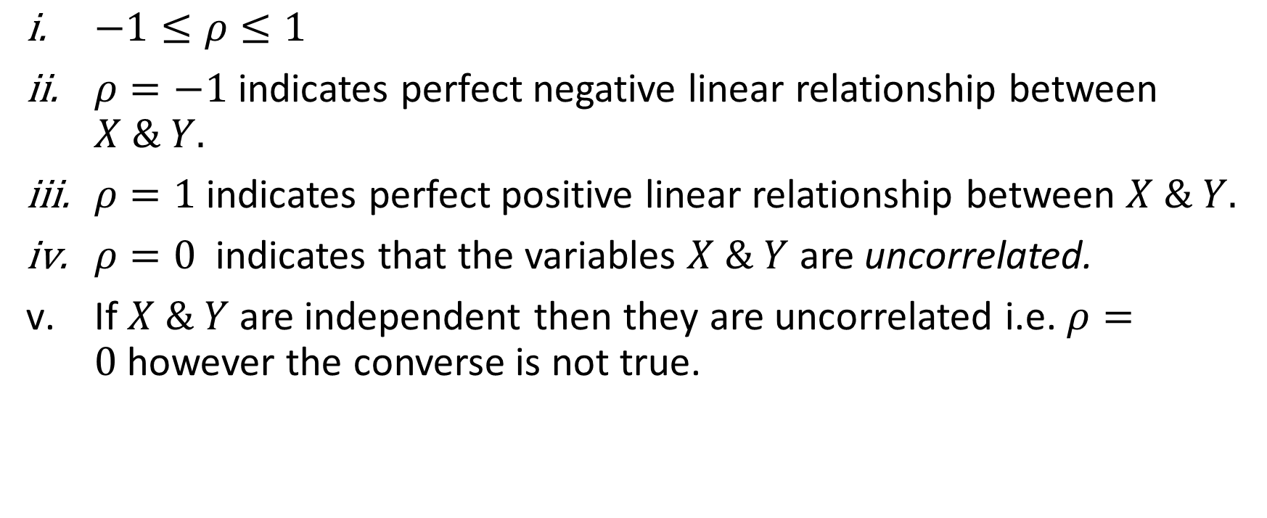
Properties of correlation coefficient:
$−1≤ρ≤1$
$ρ=−1$indicates perfect negative linear relationship between $X \& Y.$
$ρ=1$indicates perfect positive linear relationship between $X \& Y.$
$ρ=0$indicates that the variables $X \& Y$ are uncorrelated.
If $X \& Y$ are independent then they are uncorrelated i.e. $ρ=0$however the converse is not true.

Slide 55
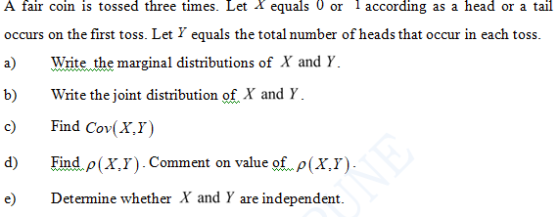
Examples

Slide 56


